Slide 1
WortWorm Documentation

Slide 2
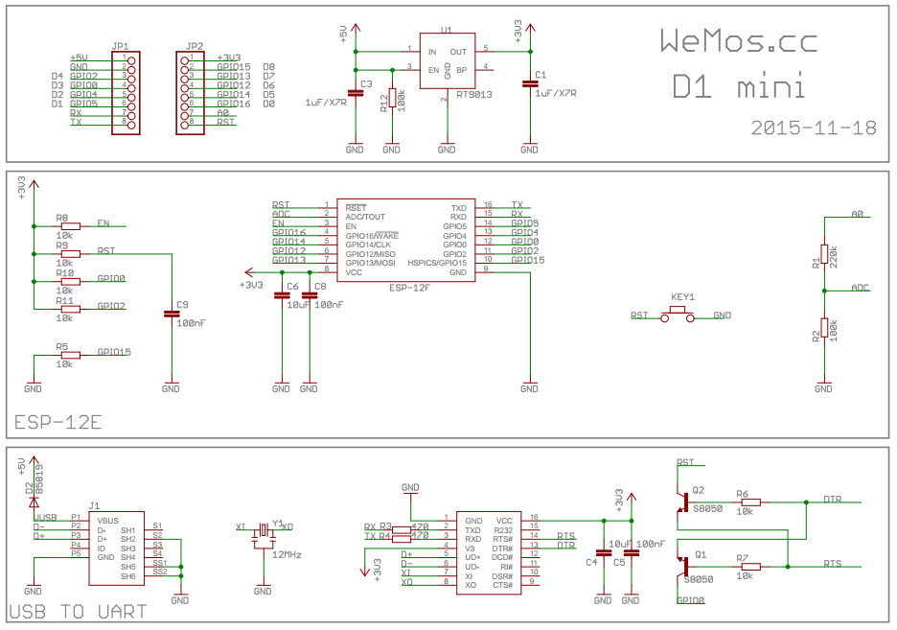
WEMOS D1 MINI Schematic

Slide 3
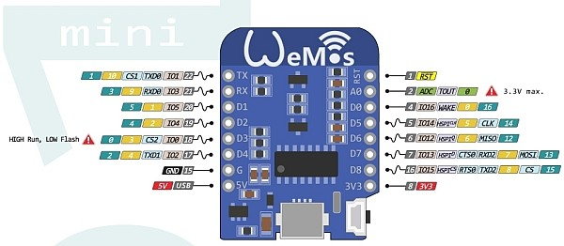
WEMOS D1 Mini Pinout

Slide 4
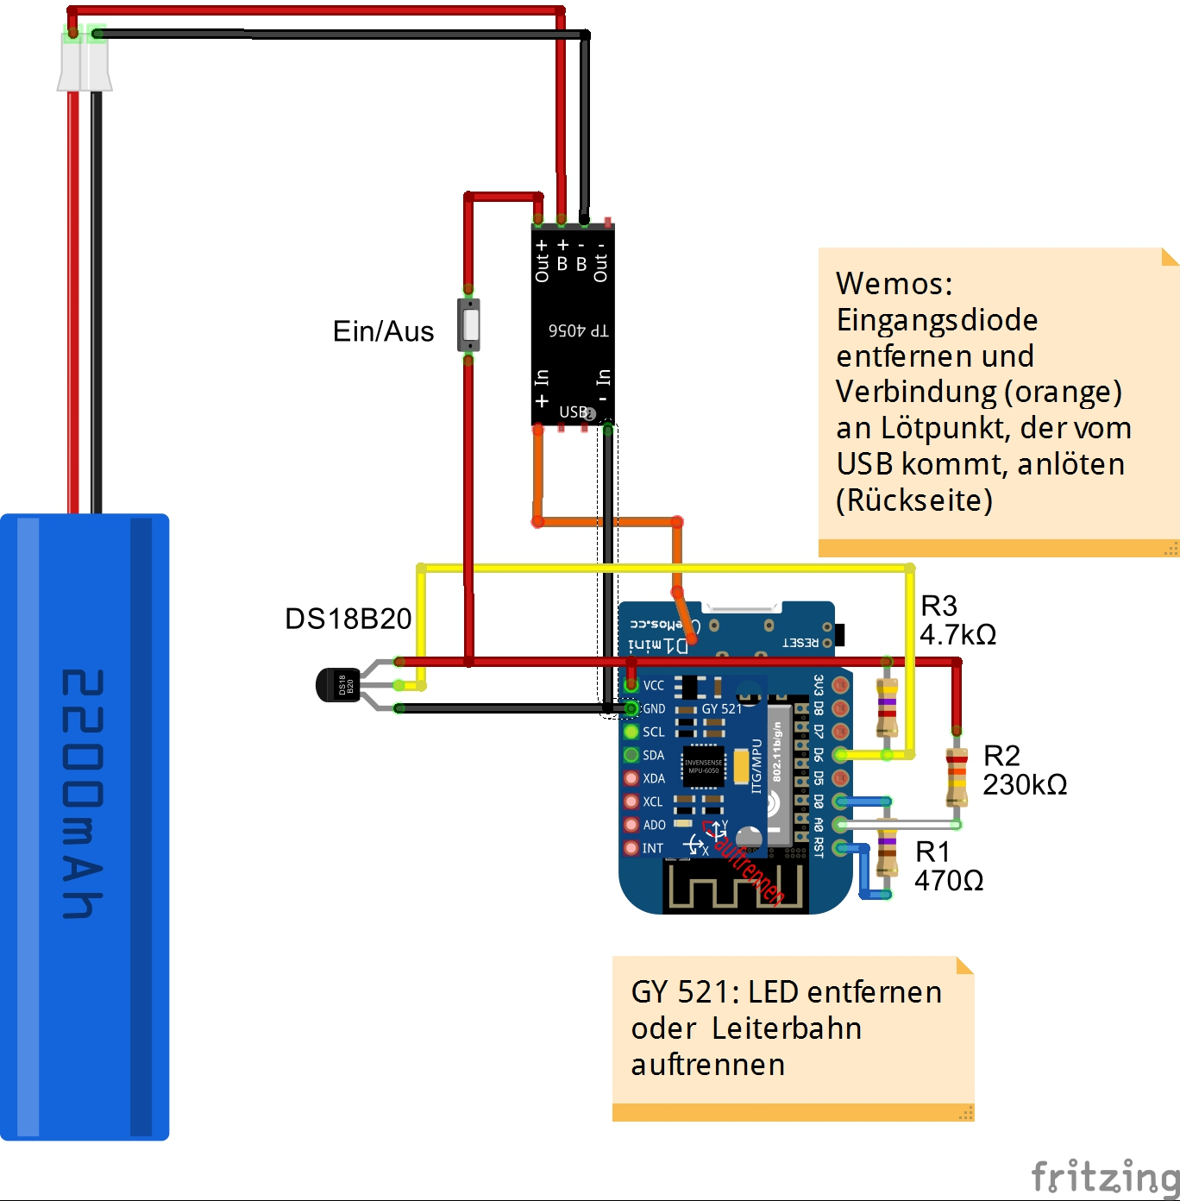
D0 (GPIO16) connected to RST
-special use for wakeup from deep sleep

Slide 5
ADC for Battery Voltage Detection
Detects when we need to recharge
ADC of ESP8266 has max input of 1V
100k/(100k + 220k)= 1/3.2 voltage divider internal to Wemos D1 – max input of Wemos (pin A0) ~3.2V
Add additional 230kOhm resistance to divider
Means total voltage divider of 100k/(100k+220k+230k)=1/5.5
Nominal 3.7V battery (up to 4V at full charge) is well within input limits to ESP8266

Slide 6
Micropython Installation
Install esptool
>> pip install esptool
Requires pyserial and other dependencies
Download latest stable .bin file
http://micropython.org/download#esp8266

Slide 7
Flashing the ESP8266 with Micropython
https://docs.micropython.org/en/latest/esp8266/esp8266/tutorial/intro.html
Command line (from location of bin file):
Verify COM port in device manager
>>python C:\Python27\Lib\site-packages\esptool.py --port COM4 --baud 460800 write_flash --flash_size=detect 0 esp8266-20170108-v1.8.7.bin
Change baud rate to lower (155200) if there are errors

Slide 8
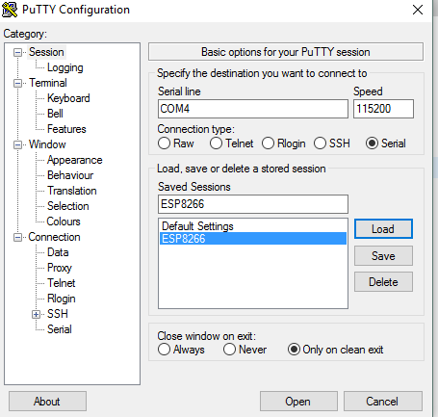
Connect to ESP8266 REPL
Use putty

Slide 9
Create WebREPL for Wifi connection
Allows us to send files to the ESP8266 and exp’t with some scripting without connecting via USB – still need power to the board though
From serial connection (putty)
>> import webrepl_setup
Set up password: ‘suckit’
Restart Wemos and connect to AP MicroPython-xxxxdd
Password = micropythoN
Goto http://micropython.org/webrepl/ and connect to ESP8266 via Wifi
Can also use to send files (i.e. main.py and library files)

Slide 10
Install ampy for easier file transfer
>> pip install ampy
C:\Users\Modtland\Dropbox (Personal)\ PythonProjects\WortWorm\test>> ampy --port COM4 put main_test.py /main.py
‘put’ command transfers file in PWD called main_test.py to ESP8266 and calls it ‘main.py’
Make sure to call file on ESP main.py to run upon boot
Must be in ‘/’ folder (root) of ESP to run automatically
Once file is transferred, can connect with putty to run files

Slide 11
Networking Basics
https://docs.micropython.org/en/latest/esp8266/esp8266/tutorial/network_basics.html
Upon boot, connect to local Wifi network to send data
Happens after each sleep cycle to save battery from staying connected
def do_connect(): import network wlan = network.WLAN(network.STA_IF) wlan.active(True) if not wlan.isconnected(): print('connecting to network...') wlan.connect(SSID, ‘password') while not wlan.isconnected(): pass print('network config:', wlan.ifconfig())

Slide 12
One Wire Comm for Temp Sensor
# The DS18x20 temperature sensor is on GPIO12 dat = machine.Pin(12) #D5 ds = ds18x20.DS18X20(onewire.OneWire(dat)) # for taking temperatures with the DS18x20 def getTemperature(dsObj): addr = dsObj.scan() dsObj.convert_temp() time.sleep_ms(750) #Wait a minimum of 750ms before readout dsObj.read_temp(addr[0]) #assuming only one device attached

Slide 13
I2C Communication
http://docs.micropython.org/en/latest/wipy/library/machine.I2C.html

Slide 14
Gyro/Accel GY-521 and MPU6050
https://github.com/jeffmer/micropython-upybbot/blob/master/mpu6050.py
Datasheet for registers: https://www.invensense.com/wp-content/uploads/2015/02/MPU-6500-Register-Map2.pdf

Slide 15
Calculating Tilt

Slide 16
Battery Voltage (Low Battery Detection)
ADC_DIVISOR = 5.5/1024 #voltage divider / resolution of ADC ~ 191.0 - exact by meassuring precise resistances/voltages # ADC for reading battery voltage bat_adc = machine.ADC(0) def getBattery(): bat_adc.read() #drop first read volt = bat_adc.read() #ESP Input 0-1V, reads 0-1024 return volt / ADC_DIVISOR #voltage divider factor

Slide 17
Ubidots
Ubidots cloud service for data storage and display
https://app.ubidots.com/ubi/datasources/#/detail/58cf639576254273691f6c3a
Need to create free account on Ubidots
Acct will have unique TOKEN # - need to add to firmware for HTTP POST request to work
Create device called ‘wortworm’ – need device label for code to work
Create 3 variables under WortWorm device and change labels to match
Temperature – label=‘temp’
Tilt Angle – label = ‘tilt’
Battery Voltage – label = ‘volt’

Slide 18
Ubidots
https://github.com/ubidots/ubidots-python
https://ubidots.com/docs/api/ - Ubidots RESTful API
class Ubidots(): """ Ubidots object representing one device on the Ubidots cloud data service for storing and plotting data """ def __init__(self, api_token, device_label): self.api_token = api_token self.api_URL = 'http://things.ubidots.com/api/v1.6/' self.device_label = device_label def send(self, var_label, value): url = self.api_URL + 'devices/%s/?token=%s' % (self.device_label, self.api_token) #print(url) payload = {var_label:value} header = {'Accept': 'application/json',"Content-Type": "application/json"} #print(payload) r = urequests.post(url, json = payload, headers=header) #print(r.content) #var = self.api.get_variable(var_id) #var.save_value({'value': value}) def send_all(self, dict_values): """ dict_values is dictionary of {'var_label':value, 'var2_label':value, ...} to be sent """ url = self.api_URL + 'devices/%s/?token=%s' % (self.device_label, self.api_token) header = {'Accept': 'application/json',"Content-Type": "application/json"} payload = dict_values r = urequests.post(url, json = payload, headers = header)

Slide 19
class WortWorm(): def __init__(self, GY521, DS_sensor, Battery_sensor, ubidots_device_label): # GY521 gyro/accelerometer sensor connected via I2C on Pins 2 (SCL) and 0 (SDA) self.accel = GY521 # The DS18x20 temperature sensor object is on GPIO12 self.ds = DS_sensor # ADC object for reading battery voltage self.batt = Battery_sensor #ubidots self.ubi = Ubidots(api_token=UBIDOTS_API_TOKEN, device_label = ubidots_device_label) self.var_ids = {'temp': UBI_TEMP_ID, 'tilt': UBI_TILT_ID, 'battery': UBI_VOLT_ID}
def send2Ubidots(self, variable_label, value): #var_id = self.var_ids[variable_label] #print(var_id) self.ubi.send(variable_label, value) def sendAll2Ubidots(self, var_dict): self.ubi.send_all(var_dict)

Slide 20
Deep Sleep Timer

Slide 21
Finite State Machine
PWR ON or RESET
(Deep Sleep)
Reset detector
Double Reset Detected
Config/
Program
Create Config File
No Double
Reset
Initialize
Measure & Calc
Transmit Data
Deep Sleep
Connect to Wifi
(later) use config file
Create RTL timer for deep sleep
Double Reset Detector for Program/Config mode
Init sensors
Create WW object
Ubidots Acct
Measure Temp
Measure Tilt with Accelerometer
Measure ADC –
battery voltage
Calculate Specific Gravity from Tilt
TX temp, tilt, SG, and battery voltage to Ubidots
Enter deep sleep mode for 60 min

Slide 22
Config / Program Mode = Double Reset
Press the reset button twice within the timeout period (default = 5 seconds) to enter configuration prompt
To reprogram the firmware:
Power off & power on
Start REPL (putty) and do a soft reboot – a hard reboot starts the deep sleep cycle
Use ampy to reprogram
Cannot be in deep sleep cycle or it won’t program

Slide 23
Config File – Stored on ESP8266
Wifi params – SSID and password
Ubidots information
SG calculation calibration(?)

Slide 24
Double Reset Detector
Allows you to hit the reset button again after an initial reset press (within a timeout amount) to enter configuration or program mode
Prevents WortWorm from getting stuck in infinite deep sleep loop
Allows reprogramming of the ESP8266 with new firmware
Allows new configuration or calibration – either after hardware change or location change (i.e. new Wifi or Ubidots verification)
Uses RTL memory to hold state through each reset
Default Timeout is 5 seconds which can be adjusted
Code basically works as:
Each reset – Reads RTL memory to figure out the state of last reset
First reset – store state in RTL memory and initialize the timer
Second reset within timeout period – Dbl Reset Detected! Clear RTL memory
Timeout occurs b4 second reset – No Dbl Reset. Clear RTL memory

Slide 25
class DoubleResetDetector(): def __init__(self, timeout = 1000): self.timeout = timeout def create_timer(self): drd_timer = machine.Timer(1) drd_timer.init(period = self.timeout, mode=machine.Timer.ONE_SHOT, callback = self.timer_expired) def timer_expired(self, drd_timer): print('DRD Timeout!') self.clearRecentResetFlag() def detectDoubleReset(self): detectDR = self.detectRecentResetFlag() if detectDR: print('Double Reset Detected') self.clearRecentResetFlag() else: #first reset self.setRecentResetFlag() #start timer return detectDR def detectRecentResetFlag(self): doubleResetDetectorFlag = machine.RTC().memory() doubleResetDetected = (doubleResetDetectorFlag == b'First Reset') return doubleResetDetected def setRecentResetFlag(self): print('First Reset') machine.RTC().memory(b'First Reset') self.create_timer() def clearRecentResetFlag(self): print('Clearing DRD') machine.RTC().memory(b'')

Slide 26
Dbl Reset Detector (DRD) in main code
## Main micropython.alloc_emergency_exception_buf(100) drd = DoubleResetDetector(timeout=DBL_RST_TIMEOUT) if machine.reset_cause() == machine.HARD_RESET: print('Hard Reset') if drd.detectDoubleReset(): print('Double Reset') sys.exit() # check if the device woke from a deep sleep reset_cause = machine.reset_cause() if reset_cause == machine.DEEPSLEEP_RESET: print('woke from a deep sleep') elif reset_cause == machine.SOFT_RESET: print('woke from a soft reset') elif reset_cause == machine.PWRON_RESET: print('woke frome power on event')

